Slide 1
Spam Email Detection ML Project
Santa Teresa Machine Learning Summer Internship
Vijay Singh
Ronak Desai, Benjamin Doan, Leon Sebastian Mathew, Ryan Li
Notes:
Ronak

Slide 2
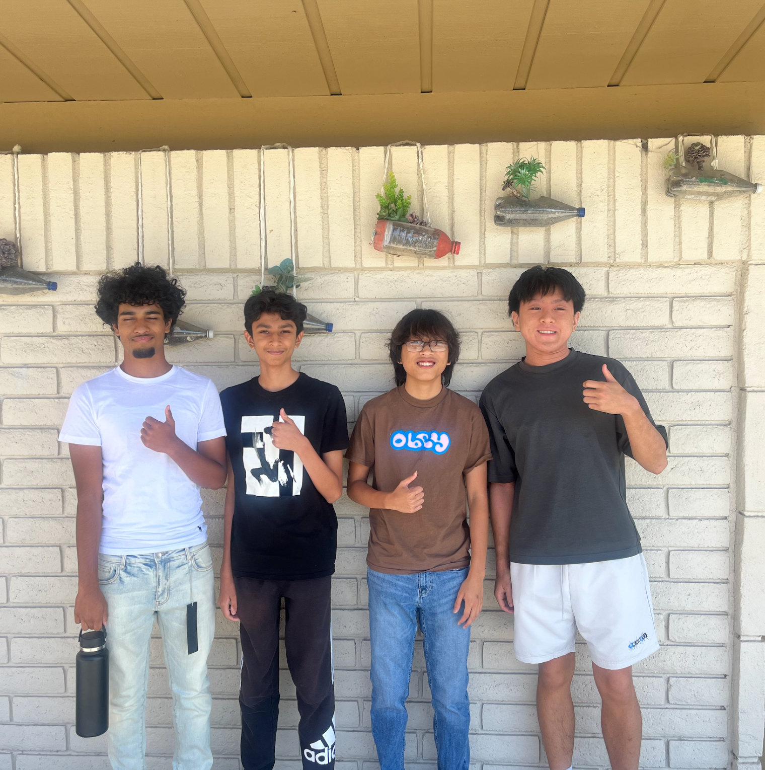
Presented By: Benjamin Doan, Ronak Desai, Leon Mathew, Ryan Li
Tesla
Leon M.
Ryan Li
Ronak D.
Ben D.
Notes:
r

Slide 3
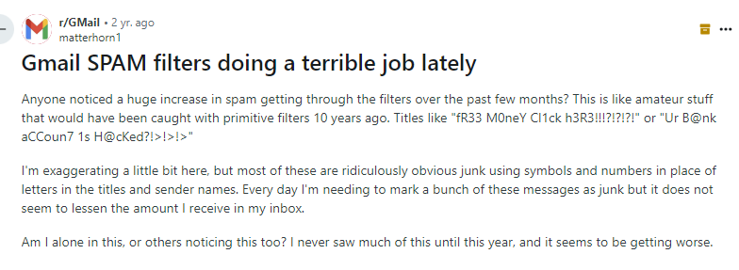
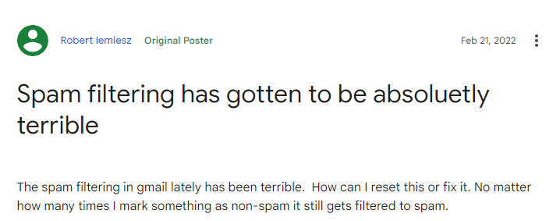
Problem:
Google’s AI for determining what is spam and what is real is very inaccurate.
Valuable messages are constantly being marked as spam
Notes:
Ronak

Slide 4

Solution:
We created our own AI spam email detector
We trained our model with approximately 10,000 emails
used the remaining 4,000 to test the model.
Notes:
Ronak

Slide 5
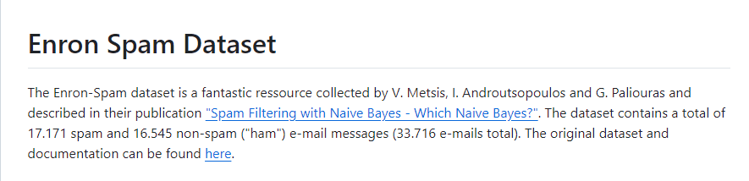
Dataset
01
We found a dataset which contained 50,000 emails and cut it down to around 15,000 emails
Notes:
Leon

Slide 6
Vectorization
02
Vectorization is the process of converting input data from its raw format (i.e. text ) into vectors of real numbers.
We use TFIDF vectorization in our code
converted the “Subject” and “Message” columns into numerical vectors
Notes:
Leon

Slide 7
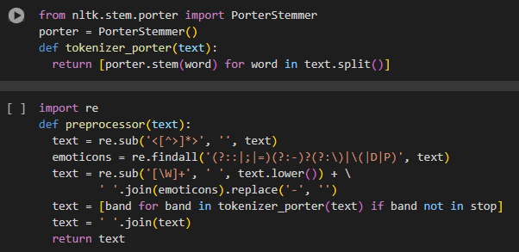
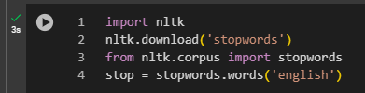
PreProcessor
03
The PreProcessor function in our code removes markups, emoji, stopwords,
Also converts all uppercase text to lowercase.
Notes:
Leon

Slide 8
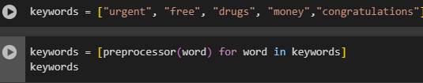
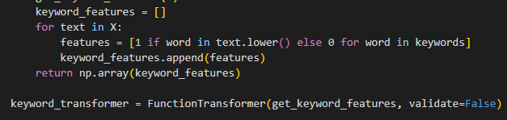
Keywords
04
A function that returns an array of 1s and 0s depending on the presence of the keywords.
Turned into a transformer
Notes:
Leon We turned it into a transformer so we could smoothly implement it into our pipeline.

Slide 9

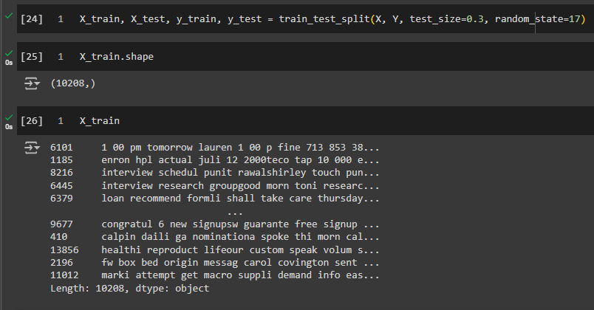
Training
05
Used the Train_Test_split tool from sklearn
split the data into 70% training and 30% testing.
Around 10,000 training emails and around 4500 testing emails.
Notes:
Ryan’s slide

Slide 10
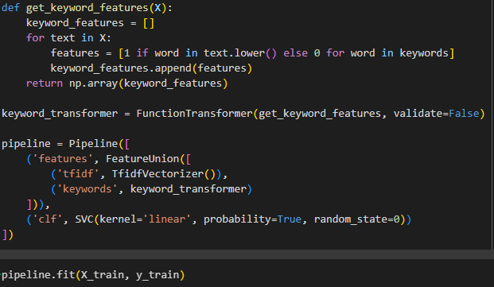
Training
06
We used a pipeline to organize our learning algorithm.
The pipeline vectorizes the data with TF-IDF
Uses keyword_transformer to get the keyword array.
FeatureUnion combines the two features.
We used a linear SVC algorithm
Notes:
Ben

Slide 11
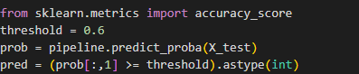
Final Touches
07
Manipulated the threshold by initializing a variable, then comparing the probability to the threshold.
This is so we can balance the results and have less false positives
Notes:
Ryan’s slide

Slide 12
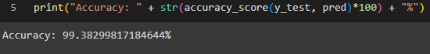
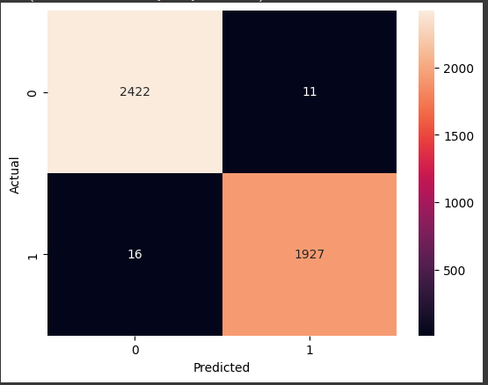
Results
08
Our results show a 99.38% accuracy.
balanced amount of false negatives and positives
Notes:
Ben

